Slide 1

Communication and Tracking System for a Stratospheric Balloon
Denzel Stockenström Verster
Supervisor: Prof. Gunther Drevin
Notes:
Good day. I am Denzel Verster, and my project is a communication and tracking system for a stratospheric balloon. My supervisor is Professor Gunther Drevin.

Slide 2

Problem statement
Tracking, telemetry and payload recovery at 20 to 30 km
Strict power, weight and bandwidth limits
Cellular networks do not serve aerial users
Research question
How can a reliable, power-efficient communication and tracking system be built for a stratospheric balloon?
Plan
GPS positioning + UHF link + ground station
Notes:
Research balloons flying at twenty to thirty kilometres need telemetry to be followed, and a way to find the payload after landing. But power, weight and bandwidth are limited, and cellular networks serve people on the ground. My question was: how can a reliable, power-efficient communication and tracking system be built for a stratospheric balloon? My plan was GPS positioning, a long-range UHF link and a matching ground station.

Slide 3
Methodology
Pragmatic paradigm, design science research
Quantitative metrics: packet success, signal strength, range
Ethics: information leakage, spectrum rules, flight safety
Cycle 1
GPS interface
Cycle 2
Transmitter
Cycle 3
Ground station
Evaluate
Ground tests
Evaluate
Balloon flight
Notes:
I used design science research within the pragmatic paradigm, because the outcome is a working artefact. It was built in three cycles: GPS, transmitter and ground station. Performance was measured quantitatively, first on the ground and then on a balloon flight. Ethical considerations were information leakage, spectrum rules and flight safety.

Slide 4
Key concepts from the literature
Telemetry
Collect, process and send data from a remote platform
UHF at 433 MHz
Long range at low power, with a low data rate
GPS
Position calculated from satellite timing signals
Redundancy
Send data more than once to reduce the chance of losing contact
Notes:
Four concepts matter. Telemetry is collecting and sending data from a remote platform. UHF around 433 megahertz gives long range at low power, but low data rates. GPS gives position from satellite timing. Redundancy, such as sending data more than once, reduces the chance of losing contact.

Slide 5
The artefact
Uputronics GPS
Raspberry Pi Zero
NTX2 transmitter
Airborne
434.65 MHz UHF
Ground station
Logging computer
Arduino Uno
NRX2 receiver
Frame
Preamble
Sync
Length
Payload
CRC
6 copies, every 60 s
Notes:
The airborne unit has a GPS module feeding a Raspberry Pi Zero, which sends position through a Radiometrix NTX2 transmitter on 434.65 megahertz, powered by a power bank. Every minute it sends a short packet of about thirty-three bytes: a counter, latitude, longitude, altitude and time. The NTX2 has no error checking, so I designed my own frame, with synchronisation, length, a CRC and Manchester coding, and send six copies of every frame. On the ground, an NRX2 receiver feeds an Arduino Uno, which decodes and checks each frame, and a computer logs it.

Slide 6
Demonstration: flight log excerpts
Transmitter log (Raspberry Pi Zero)
Ground-station log (decoded)
time packet,lat,lon,alt,fix x6
11:15:52 45,-26.89101,27.21973,4729,091543
11:16:52 46,-26.88520,27.22386,4937,091643
11:17:52 47,-26.87959,27.22854,5160,091743
11:18:52 48,-26.87543,27.23294,5360,091836
packet alt(m) copies RSSI(mV)
45 4729 3/6 938
46 4937 3/6 1251
47 5160 2/6 1031
48 5360 6/6 1153
Every packet is sent as six copies. Packet 47 reached the ground station with only 2 of 6 copies and was still decoded.
Notes:
These are excerpts from the flight logs. On the left, the Raspberry Pi logs each packet as it is sent, and every packet goes out as six copies. On the right, the ground station logs the same packets after decoding, with the signal strength and how many of the six copies arrived. Packet 47 arrived with only two copies, and was still decoded. This confirmed that the link worked from end to end.

Slide 7
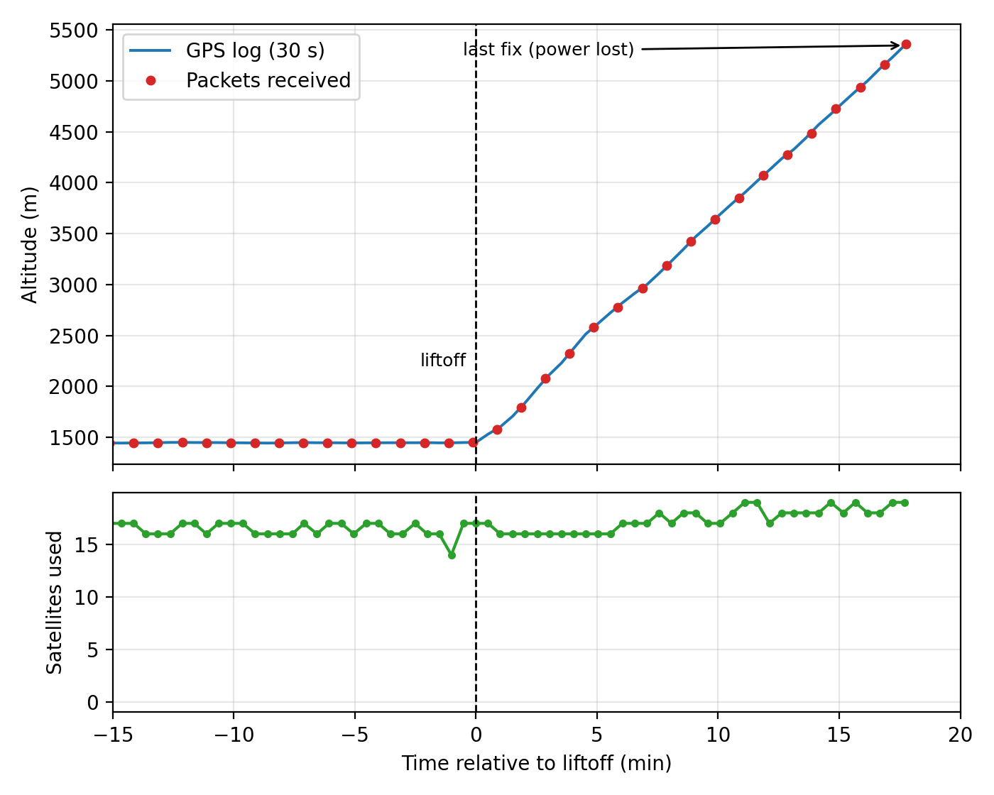
Results
5.4 km
altitude reached, at 7.2 km distance
18 / 18
airborne packets received
98.8%
of copies received in ground tests
17.5 min
of flight data, then the power bank stopped
Ground tests: GPS position varied 5.6 m on average (51 m maximum). In flight, 85% of individual copies were received.
Notes:
On the ground, stationary GPS readings varied by 5.6 metres on average, and by up to 51 metres. In link tests at up to 20 metres, every reading arrived, along with 98.8 percent of individual copies. In the balloon flight on 9 October, the system tracked the balloon up to 5.4 kilometres altitude and 7.2 kilometres distance. All 18 airborne packets arrived, even though only 85 percent of copies did, so the repeated copies worked. After about 17.5 minutes the power bank stopped supplying power, and telemetry ended.

Slide 8

Conclusion
Research question: answered in part
Achieved
Tracking up to 5.4 km
Every airborne packet received
Tested prototype of both link ends
Not yet shown
Stratospheric altitude
Power consumption
Recovery using this system
Next: repeat flight with a bench-tested power supply, measured current draw and a backup tracker
Thank you
Notes:
The prototype shows that position data can be acquired, transmitted and logged reliably when each reading is repeated, up to 5.4 kilometres. The research question is therefore answered in part. Not yet demonstrated are operation at stratospheric altitude, power consumption, and recovery using this system, since the payload was found with an independent GPS tracker. The next step is a repeat flight with a bench-tested power supply, measured current draw and a backup tracker. Thank you.

